Slide 1



Sales Analysis
View in Power BI
Last data refresh:
08/05/2023 11:46:52 UTC
Downloaded at:
08/05/2023 12:43:15 UTC

Slide 2
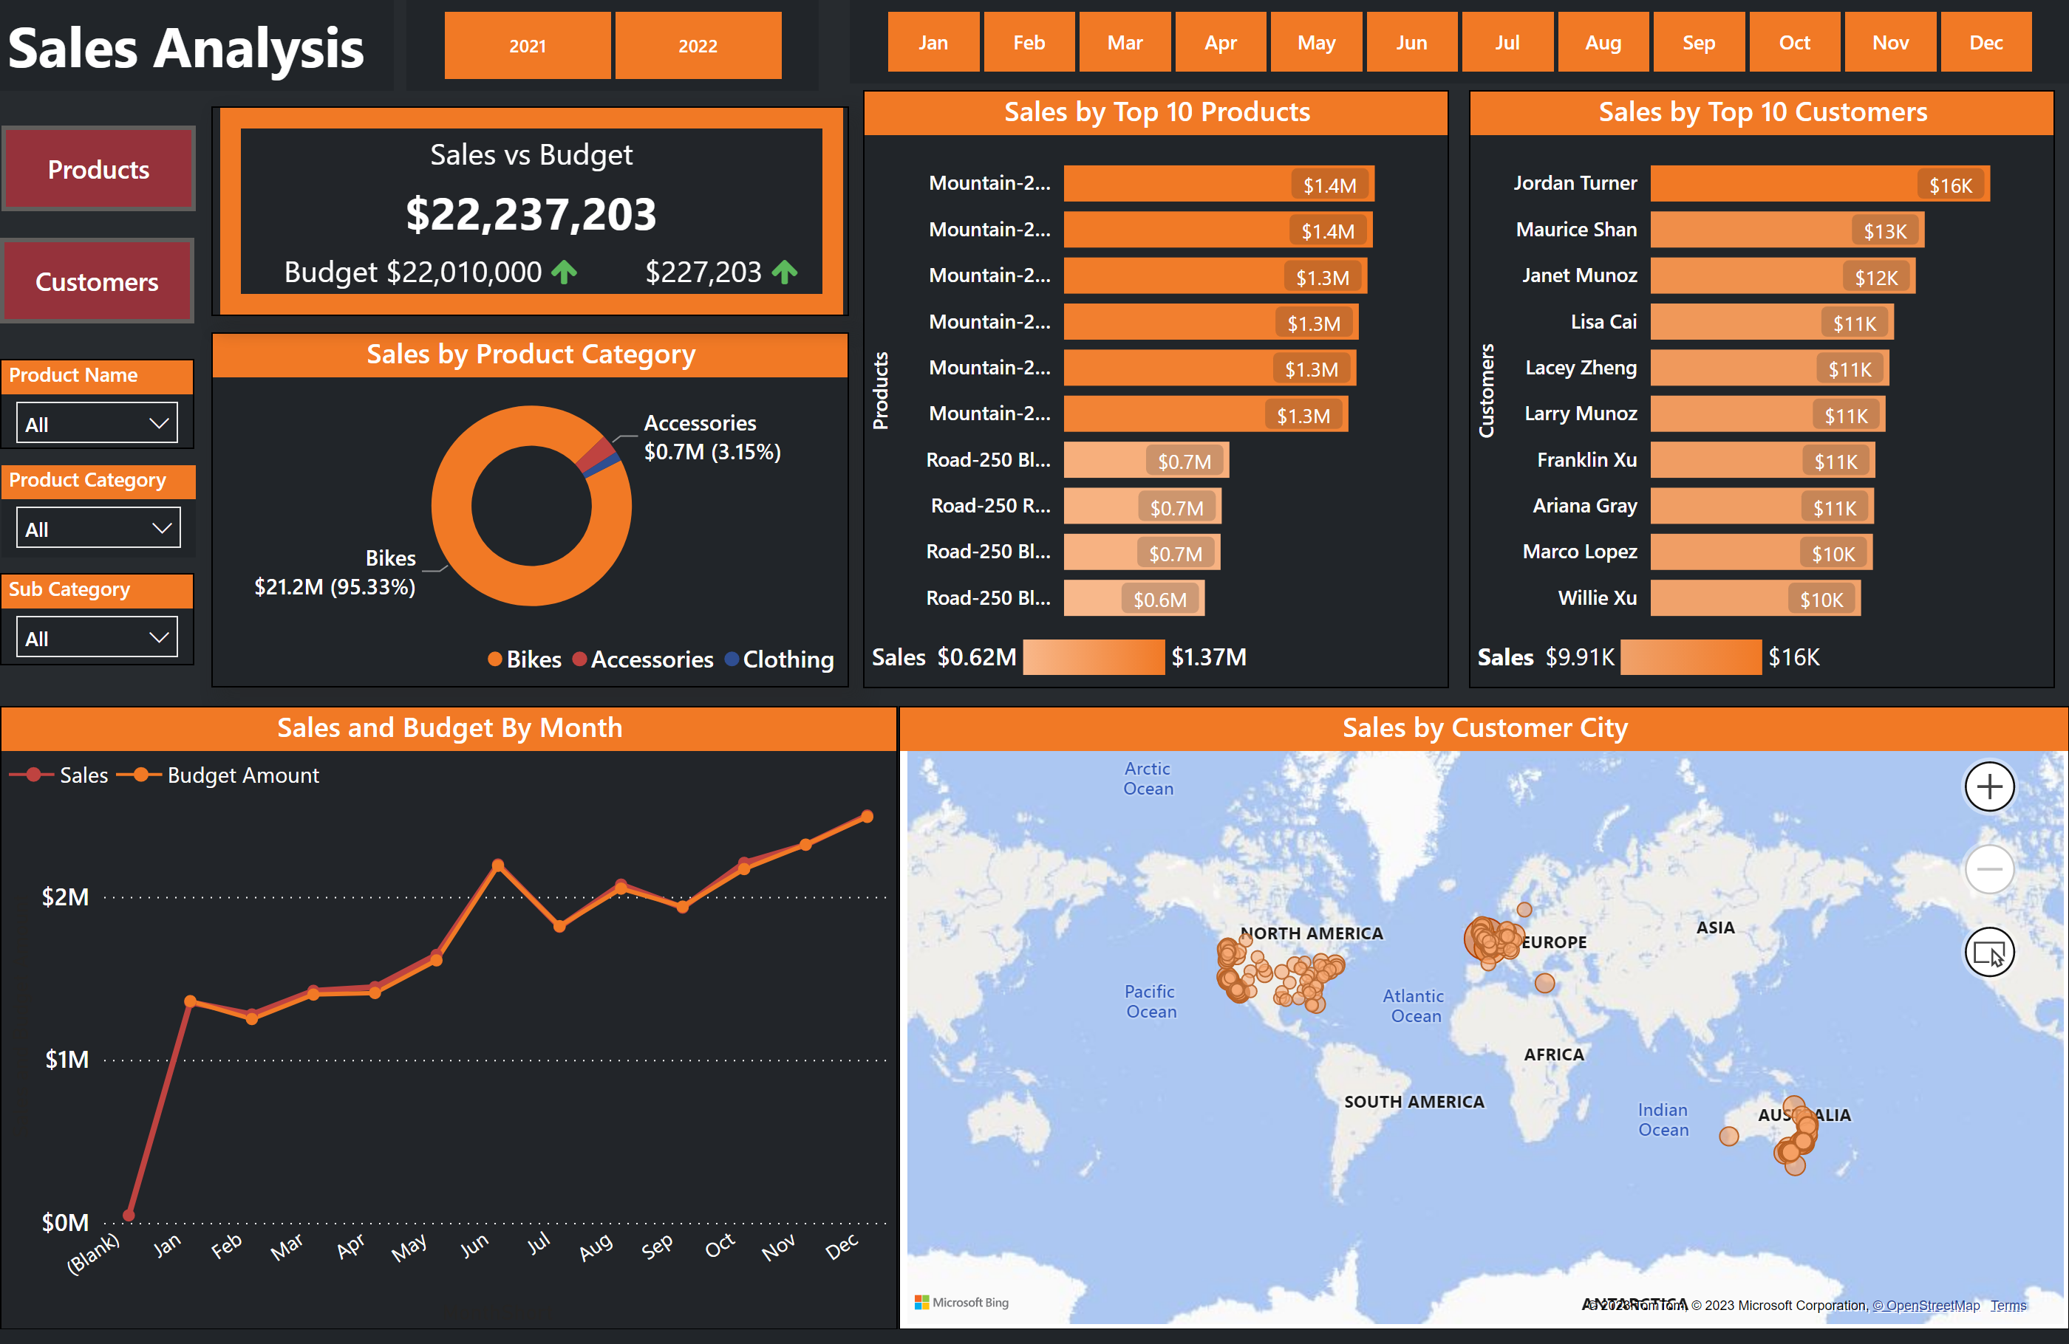
Sales Overview
Notes:
textbox
No alt text provided
slicer
No alt text provided
donutChart
No alt text provided
BBED0A4D4D8D44CE93CF2DAFADEE466C
No alt text provided
Sales and Budget By Month
No alt text provided
Product Category
No alt text provided
Sub Category
No alt text provided
Product Name
No alt text provided
map
No alt text provided
Sales by Top 10 Products
No alt text provided
Sales by Top 10 Customers
No alt text provided
slicer
No alt text provided
Sales
No alt text provided
Sales
No alt text provided

Slide 3
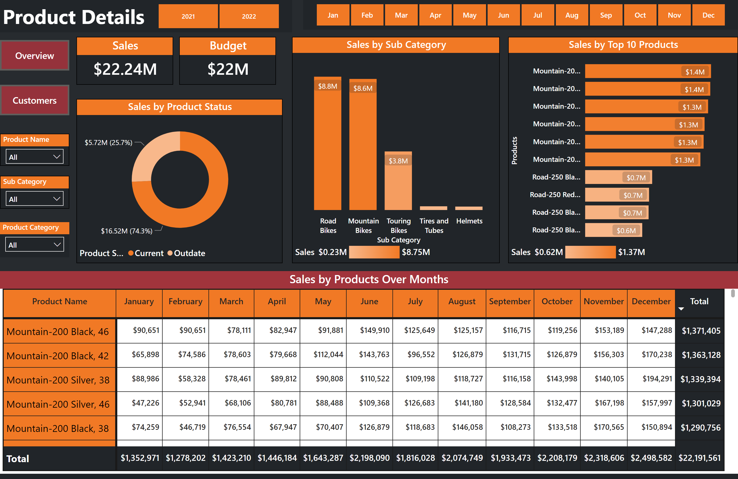
Product Details
Notes:
textbox
No alt text provided
slicer
No alt text provided
Product Category
No alt text provided
Sub Category
No alt text provided
Product Name
No alt text provided
Sales by Products Over Months
No alt text provided
slicer
No alt text provided
columnChart
No alt text provided
donutChart
No alt text provided
Sales by Top 10 Products
No alt text provided
Sales
No alt text provided
Budget
No alt text provided
Sales
No alt text provided
Sales
No alt text provided

Slide 4
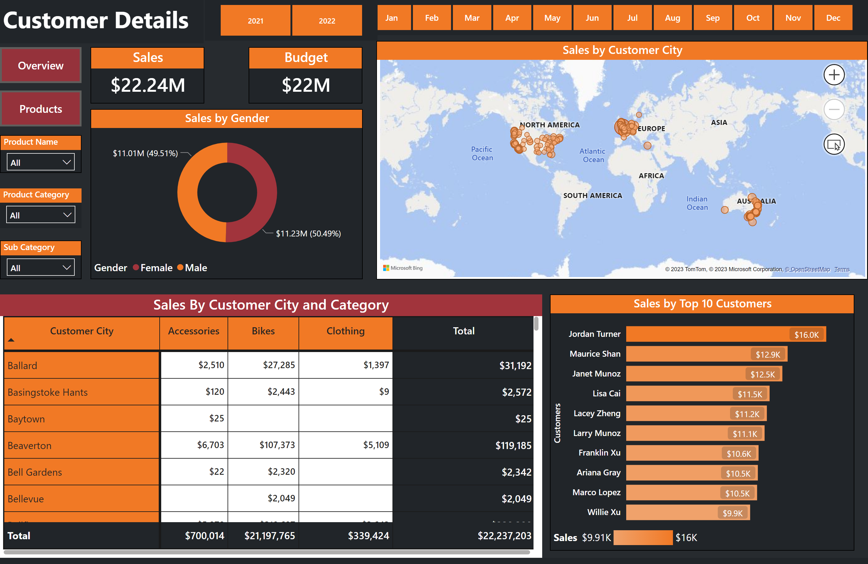
Customer Details
Notes:
textbox
No alt text provided
slicer
No alt text provided
Product Category
No alt text provided
Sub Category
No alt text provided
Product Name
No alt text provided
Sales By Customer City and Category
No alt text provided
donutChart
No alt text provided
Sales
No alt text provided
Budget
No alt text provided
Sales by Top 10 Customers
No alt text provided
map
No alt text provided
slicer
No alt text provided
slicer
No alt text provided
Sales
No alt text provided
Sales
No alt text provided

